Slide 1
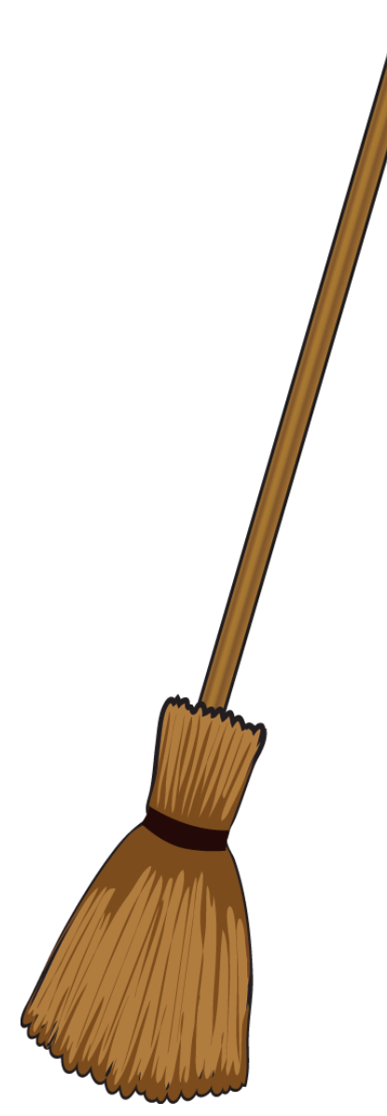
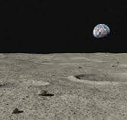
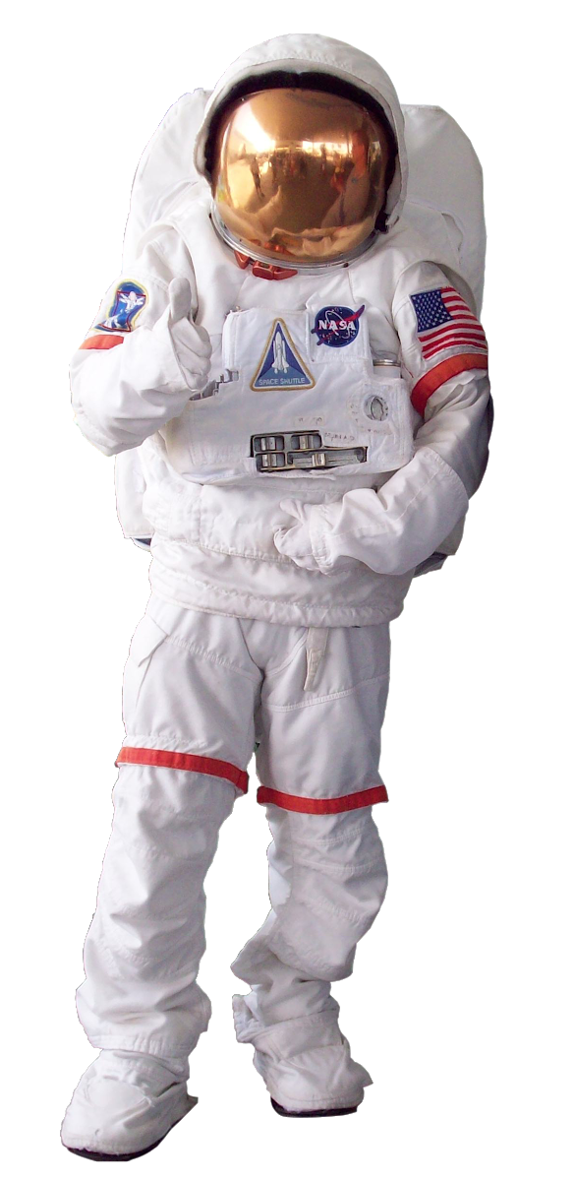
CONCEPT OF OPERATIONS
1
Astronaut should ensure the surface is relatively flat and cleared
2
Astronaut lays out E.A.S.E in front of the lunar habitat and connects it to power source
4
Astronaut leaves and E.A.S.E enters rest mode until the pressure sensor is activated by the weight of the astronaut again.
3
After moonwalk and sample collection, astronaut returns to stand on E.A.S.E, which senses the weight and begins attracting dust off of the astronauts’ boots and repelling it off itself, cleaning the astronaut and itself

Slide 2
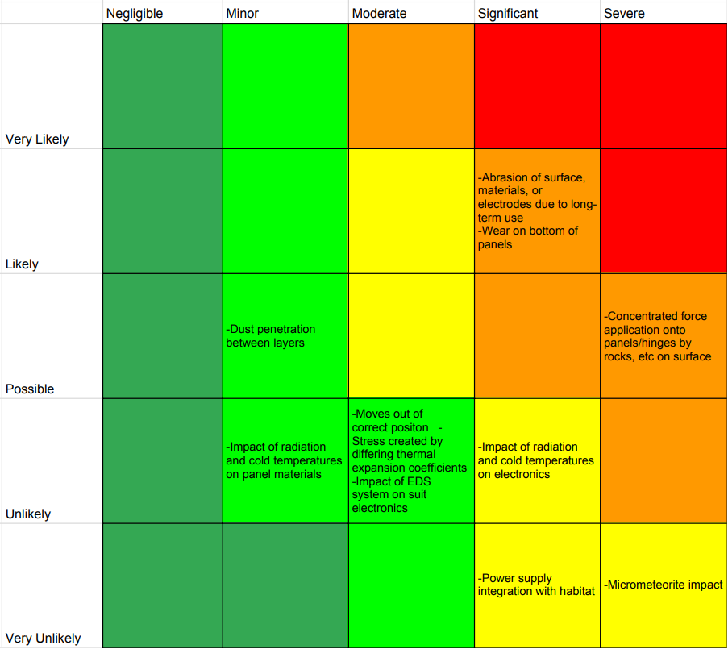
RISK ASSESSMENT CHART

